Slide 1






EF Relations Object Composition
Customizing Entity Models
EF
Relations
SoftUni Team
Technical Trainers
Software University
http://softuni.bg

Slide 2


Table of Contents
Object Composition
Navigation Properties
Table Relationships
Attributes

Slide 3
Questions
sli.do #Entity

Slide 4

Object Composition
Car
Engine
Piston

Slide 5
Object Composition
Object composition denotes a "has-a" relationship
E.g. the car has an engine
Defined in C# by one object having a property that is a reference to another
Person
Name
Age
MyDog
Dog

Slide 6
Navigation Properties
Navigation properties create a relationship between entities
Is either an EntityReference (one to one or zero) or an ICollection (one to many or many to many)
They provide fast querying of related records
Will automatically create mapping tables
Must be declared virtual to enable lazy loading (object proxy)
Can be modified by directly setting the reference

Slide 7



Table Relationships
Expressed as Properties and Attributes

Slide 8
One-to-Zero-or-One
Expressed in SQL Server as a shared primary key
Relationship direction must be explicitly specified with a ForeignKey attribute
ForeignKey is placed above the key property and contains the name of the navigation property or vice versa
Student
Address

Slide 9
One-to-Zero-or-One Implementation
public class Student
{
public int Id { get; set; }
public string Name { get; set; }
public virtual Address Address { get; set; }
}
public class Address
{
[Key]
[ForeignKey("Student")]
public int Id { get; set; }
public string Text { get; set; }
public virtual Student Student { get; set; }
}
Attributes

Slide 10
One-to-Many
Most common type of relationship
Implemented with a collection inside the parent entity
The collection must be initialized in the constructor!
Employee
Department
Employee
Employee

Slide 11
One-to-Many Implementation
public class Department
{
public Department()
{
this.Employees = new HashSet<Employee>();
}
public int Id { get; set; }
…
public virtual ICollection<Employee> Employees { get; set; }
}
public class Employee
{
public int Id { get; set; }
…
public virtual Department Department { get; set; }
}

Slide 12
Many-to-Many
Requires a mapping table (auto-generated)
Implemented with collections in each entity, referring the other
The collections must be initialized in the constructor!
Student
Course
Student
Course
Student

Slide 13
One-to-Many Implementation
public class Course
{
public Course() { this.Students = new HashSet<Student>(); }
…
public virtual ICollection<Student> Students { get; set; }
}
public class Student
{
public Student() { this.Courses = new HashSet<Courses>(); }
…
public virtual ICollection<Course> Courses { get; set; }
}

Slide 14
Multiple Relations
When two entities are related by more than one key
Entity Framework needs help from Inverse Properties
Place of Birth
Town
Person
Current Residence
Town

Slide 15
Multiple Relations Implementation
Person Domain Model – defined as usual
public class Person
{
public int Id { get; set; }
public string Name { get; set; }
public Town PlaceOfBirth { get; set; }
public Town CurrentResidence { get; set; }
}

Slide 16
Multiple Relations Implementation (2)
Town Domain Model
public class Town
{
public Town()
{
this.Natives = new HashSet<Person>();
this.Residents = new HashSet<Person>();
}
public int Id { get; set; }
public string Name { get; set; }
[InverseProperty("PlaceOfBirth")]
public ICollection<Person> Natives { get; set; }
[InverseProperty("CurrentResidence")]
public ICollection<Person> Residents { get; set; }
}
Point towards related model

Slide 17
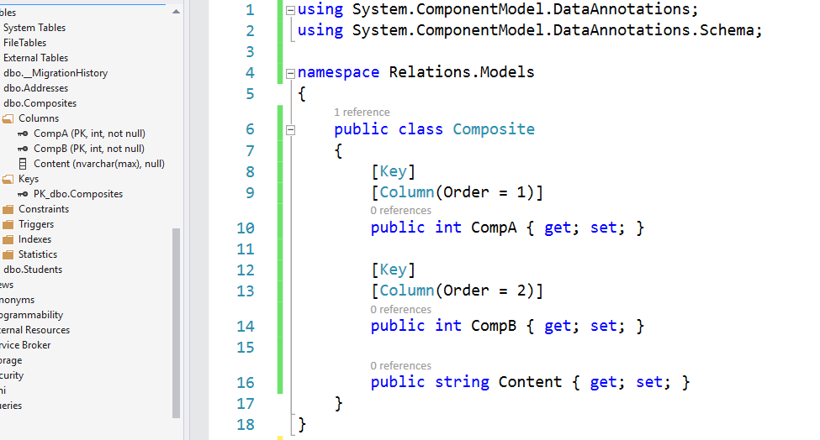
Attributes
Custom Entity Framework Behavior

Slide 18
Attributes
EF Code First provides a set of DataAnnotaion attributes
You can override default Entity Framework behavior
To access nullability and size of fields:
To access schema customizations:
For a full set of configuration options you need the Fluent API
using System.ComponentModel.DataAnnotations;
using System.ComponentModel.DataAnnotations.Schema;

Slide 19
Key Attributes
Key – explicitly specify primary key
When your PK column doesn't contain "Id" in it's name
When you want a composite key
[Key]
public int StudentKey { get; set; }
[Key]
[Column(Order=1)]
public int StudentId { get; set; }
[Key]
[Column(Order=2)]
public int CourseId { get; set; }
Key order must be explicitly specified

Slide 20
Key Attributes (2)
ForeignKey – explicitly link navigation property and foreign key property within the same class (to rename the column)
Works in either direction (FK to navigation property or navigation property to FK)
public class Client
{
…
public int OrderRefId { get; set; }
[ForeignKey("OrderRefId")]
public virtual Order Order { get; set; }
}

Slide 21
Renaming Objects
Table – manually specify the name of the table in the DB
[Table("StudentMaster")]
public class Student
{
…
}
[Table("StudentMaster", Schema="Admin")]
public class Student
{
…
}

Slide 22
Renaming Objects (2)
Column – manually specify the name of the column in the DB
You can also specify order and explicit data type
public class Student
{
…
[Column("StudentName", Order=2, TypeName="varchar(50)")]
public string Name { get; set; }
}
Optional parameters

Slide 23
Entity Validation
Required – mark a nullable property as NOT NULL in the DB
Will throw exception if not set to a value
Non-nullable types (e.g. int) will not throw an exception (will be set to language-specific default value)
MinLength – specify min length of a string (client validation)
MaxLength / StringLength – specify max length of a string (both client and DB validation)
Range – set lower and/or upper limits of numeric property (client validation)

Slide 24
Other Attributes
Index – create index for column
Primary key will always have an index
NotMapped – property will not be mapped to a column
For business logic properties
Optional name
Optional unique specifier
[Index( "INDEX_REGNUM", IsUnique=true )]
public int RegistrationNumber { get; set; }

Slide 25

Summary
Objects can be composed from other objects to represent complex relationships
Navigation properties speed up the traversal of related entities
Attributes can be used to express special table relationships and to customize entity behaviour

Slide 26








Entity Framework Relations
https://softuni.bg/courses/

Slide 27
License
This course (slides, examples, demos, videos, homework, etc.) is licensed under the "Creative Commons Attribution-NonCommercial-ShareAlike 4.0 International" license
Attribution: this work may contain portions from
"Databases" course by Telerik Academy under CC-BY-NC-SA license

Slide 28




Free Trainings @ Software University
Software University Foundation – softuni.org
Software University – High-Quality Education, Profession and Job for Software Developers
softuni.bg
Software University @ Facebook
facebook.com/SoftwareUniversity
Software University Forums
forum.softuni.bg

